Slide 1














Powerpoint 2010
C I V I C
S L I D E M A S T E R
1 K B

Slide 2









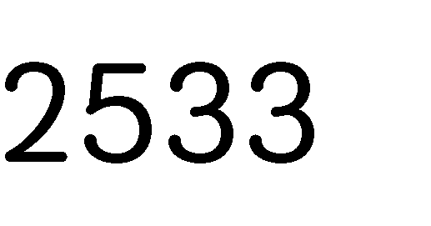

















Microsoft Office) Microsoft)
•
MS Office 1.0
•
PRO)"
Microsoft Powerpoint)
Presentation)

